Slide 1
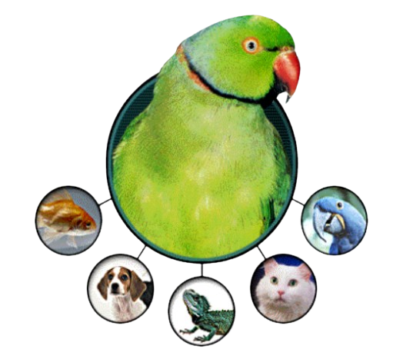

JPet Store Web Testing Project
Benny Feigin - Elina Ein Eli - Natan Koren

Slide 2

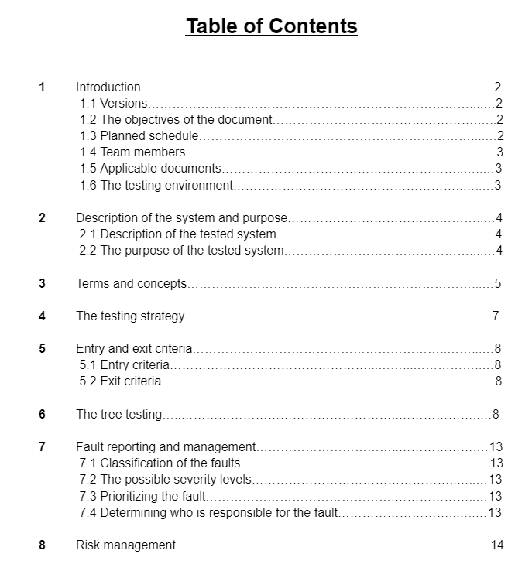



Slide 3
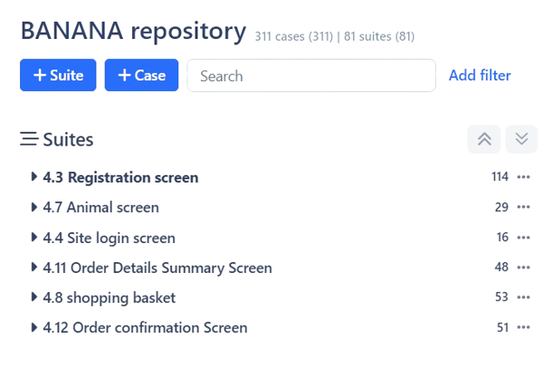


STD Document

Slide 4
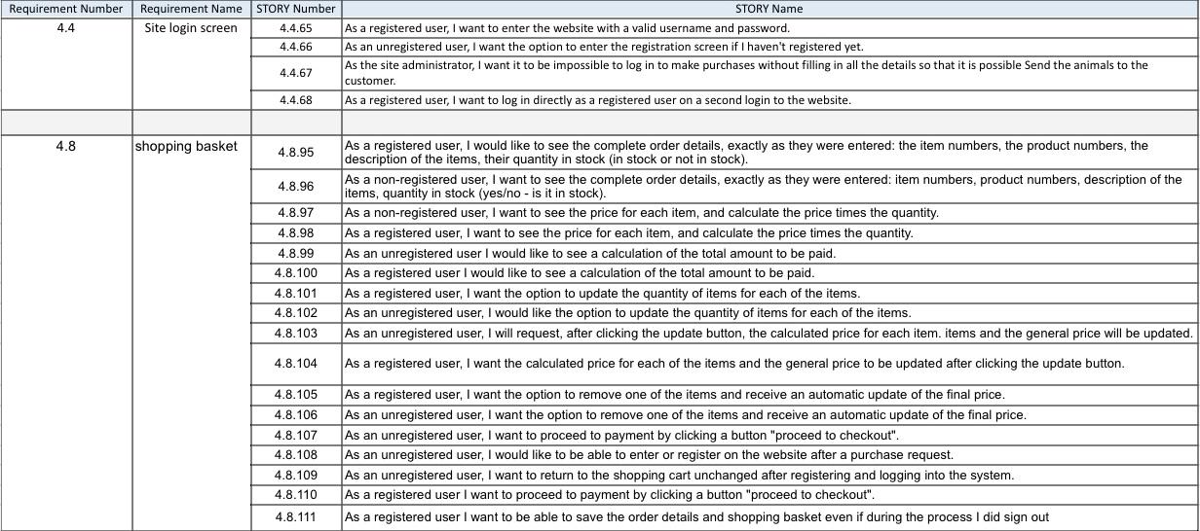
Elina Ein Eli Requirement

Slide 5
Elina Ein Eli Test Cases
The following test cases will be presented in the following slides:
4.8.100.3 - Verifying that the total payment amount updates correctly when adding multiple items
4.8.101.1 - Entering digits in the quantity field
4.8.105.3 - Verifying that when removing all items it will state in the cart that the cart is empty

Slide 6
Requirement 4.8.100
As a registered user, I want to see the calculation of the total amount due.

Slide 7
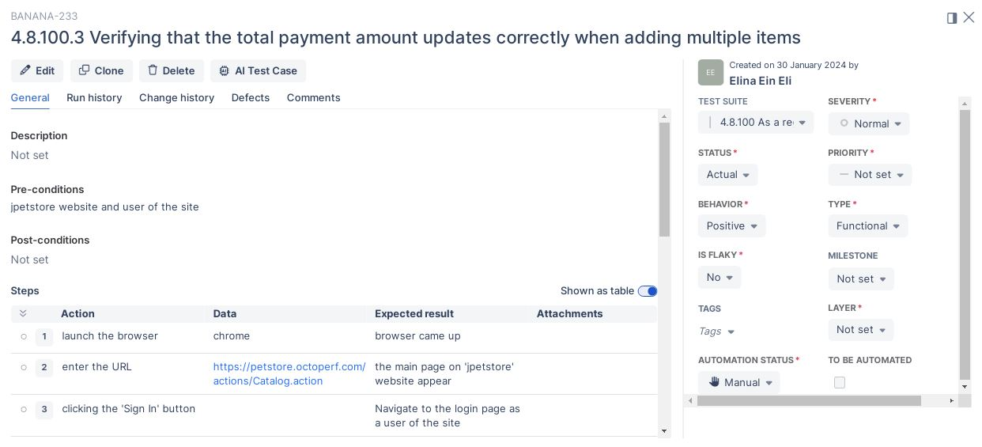
4.8.100.3 - Verifying that the total payment amount updates correctly when adding multiple items

Slide 8
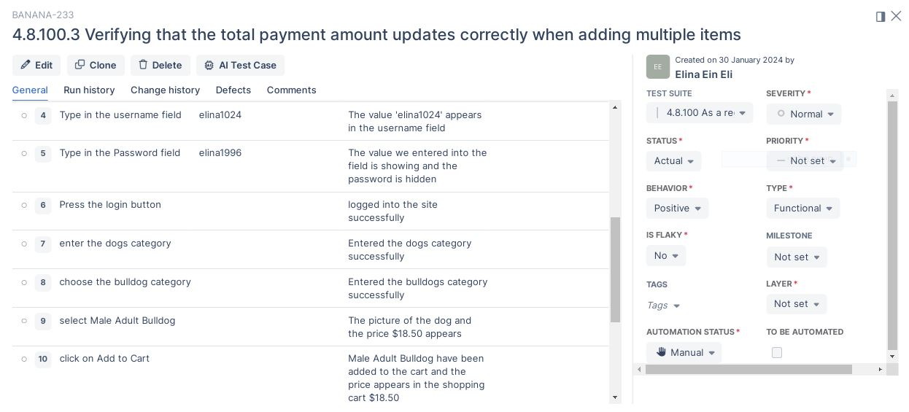
4.8.100.3 - Verifying that the total payment amount updates correctly when adding multiple items

Slide 9
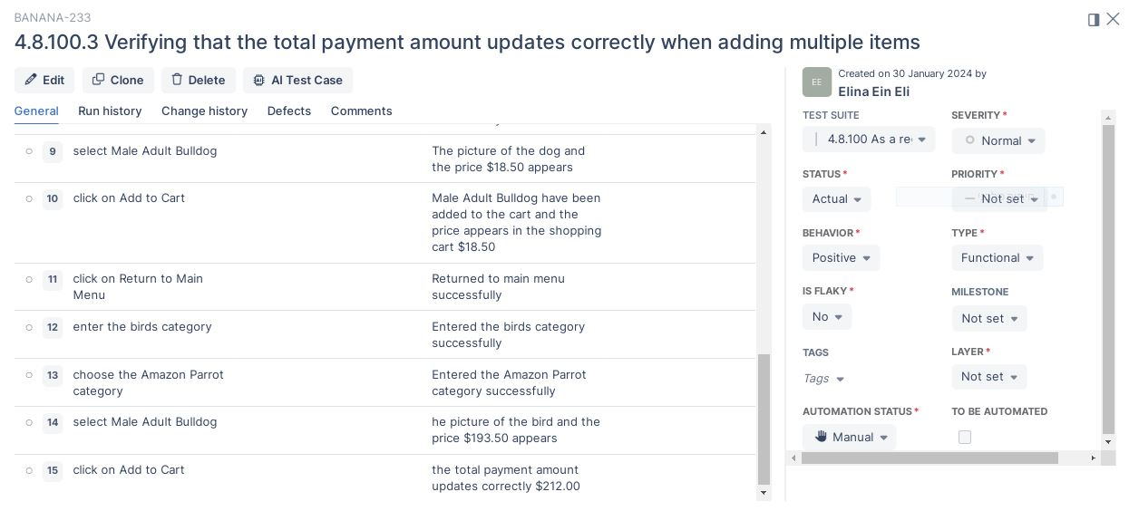
4.8.100.3 - Verifying that the total payment amount updates correctly when adding multiple items

Slide 10
Requirement 4.8.101
As a registered user, I want the ability to update the quantity for each of the items.

Slide 11
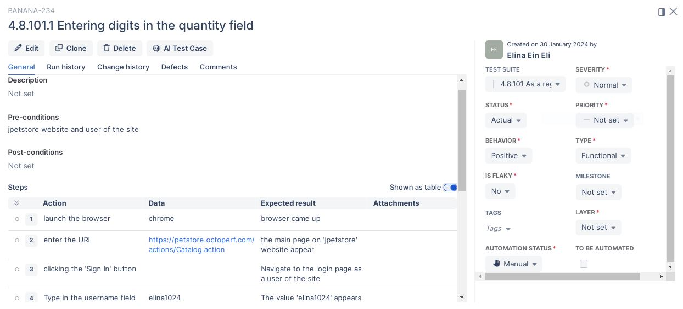
4.8.101.1 - Entering digits in the quantity field

Slide 12
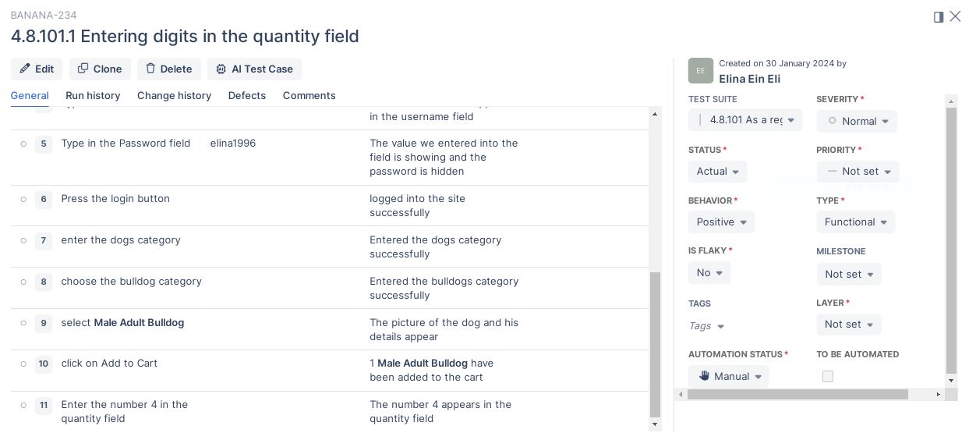
4.8.101.1 - Entering digits in the quantity field

Slide 13
Requirement 4.8.105
As a registered user, I want the ability to remove one of the items and get an automatic update of the final price.

Slide 14
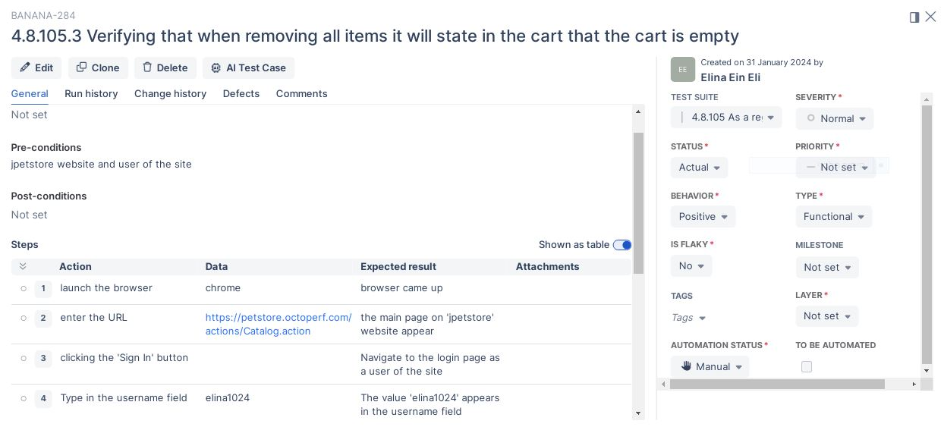
4.8.105.3 - Verifying that when removing all items it will state in the cart that the cart is empty

Slide 15
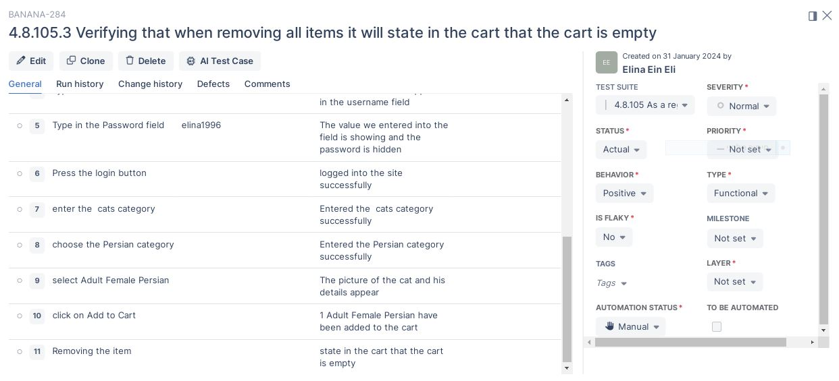
4.8.105.3 - Verifying that when removing all items it will state in the cart that the cart is empty

Slide 16
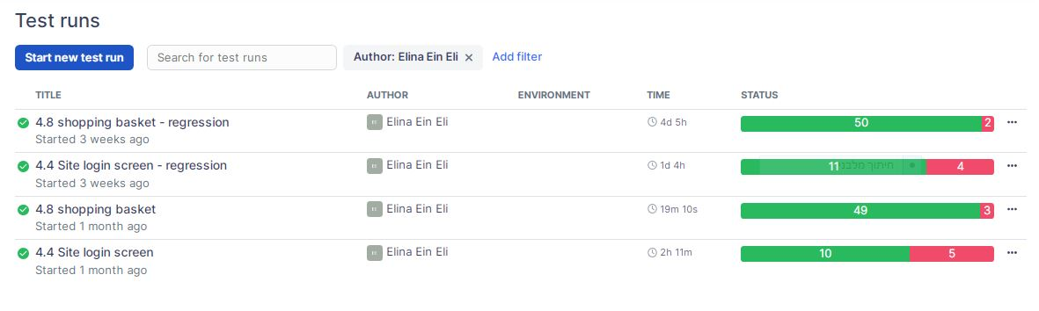
Status Test Runs

Slide 17
Elina Ein Eli Issues
the following issues will be presented in the following slides:
4.4.65.2 - Site login screen - Registered password
4.4.65.5 - Site login screen - Button does not exist

Slide 18
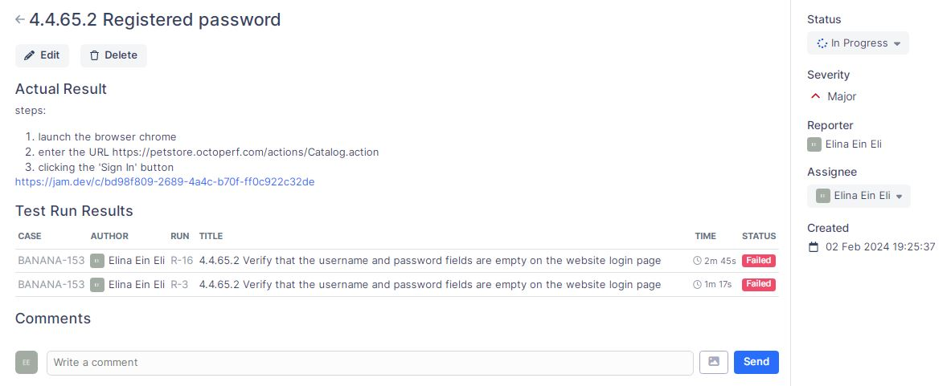
First Issue

Slide 19
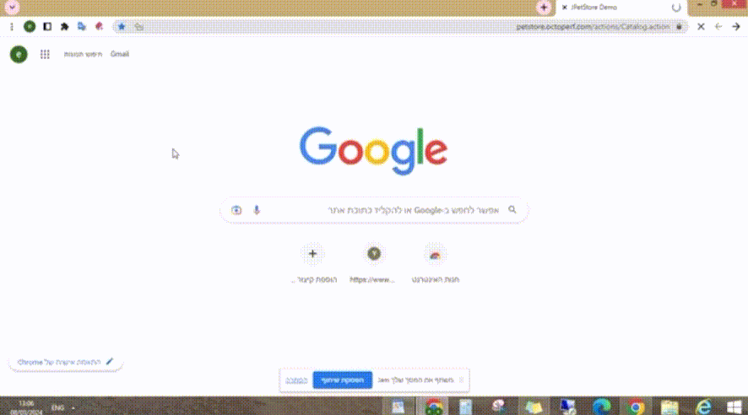
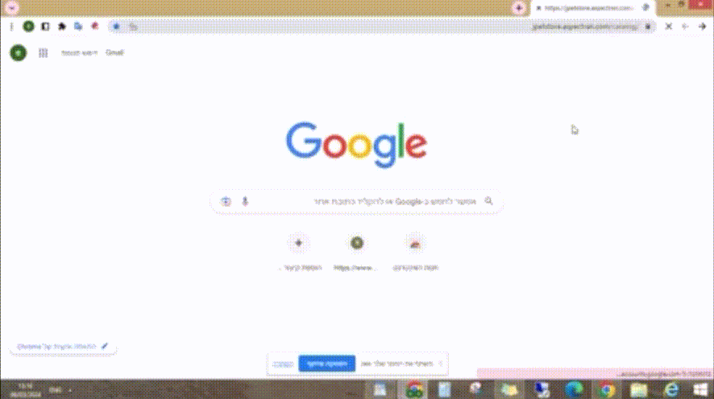
First Issue
First version
Second version

Slide 20
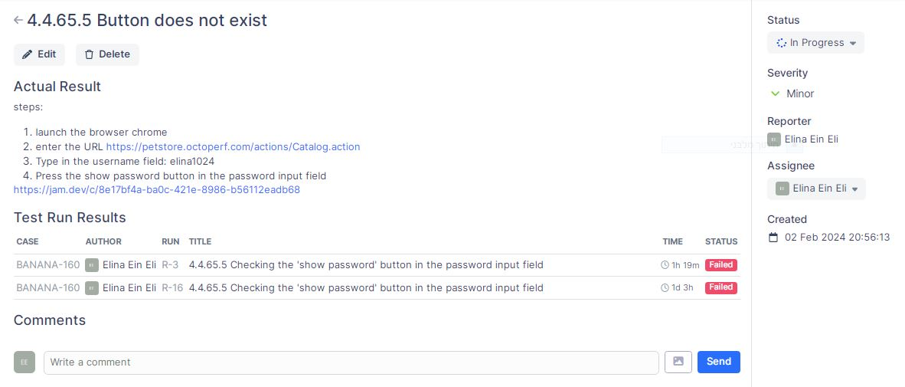
Second Issue

Slide 21
Second Issue
First version
Second version

Slide 22
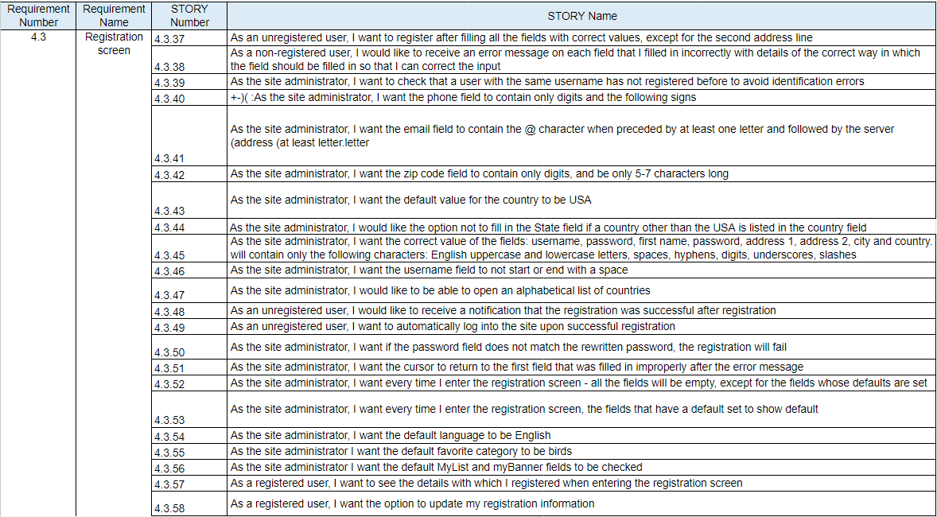
Benny Feigin
Benny's Requirement and stories

Slide 23
Benny Feigin
Benny Feigin Test Cases
The following test cases will be presented in the following slides:
Test 4.3.41.2 - Typing an invalid email format
Test 4.3.59.1 Verifying that the text in the password field appears in the form of asterisks on the Registration page
Test 4.3.45.8 Typing Hebrew letters in the username field

Slide 24
Benny Feigin
Requirement 4.3.41
As the site administrator, I want the email field to contain the @ character when preceded by at least one letter and followed by the server address (at least letter. Letter)

Slide 25
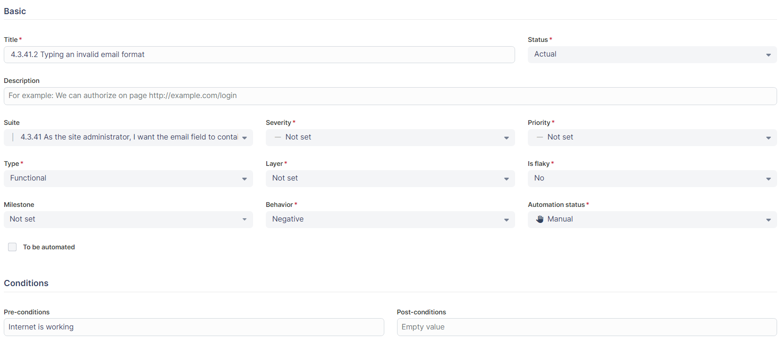
Benny Feigin
Test 4.3.41.2 - Typing an invalid email format

Slide 26
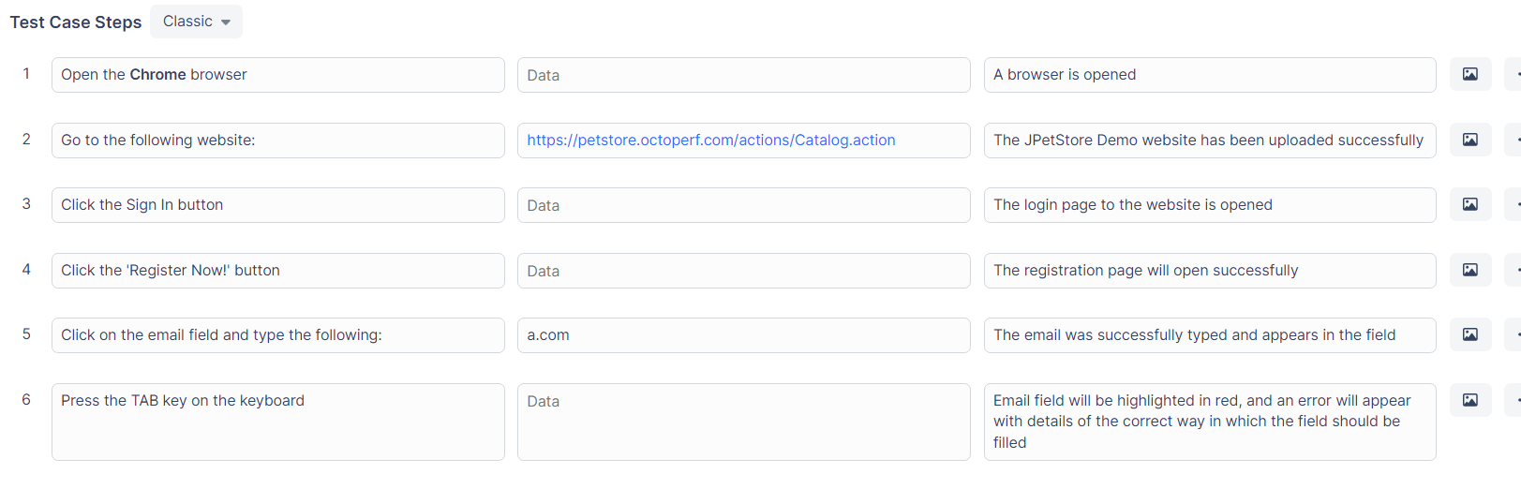
Benny Feigin
Test Case Steps

Slide 27
Benny Feigin
Requirement 4.3.59
As the site administrator, I want the password and re-password fields to appear when typing in the form of asterisks

Slide 28
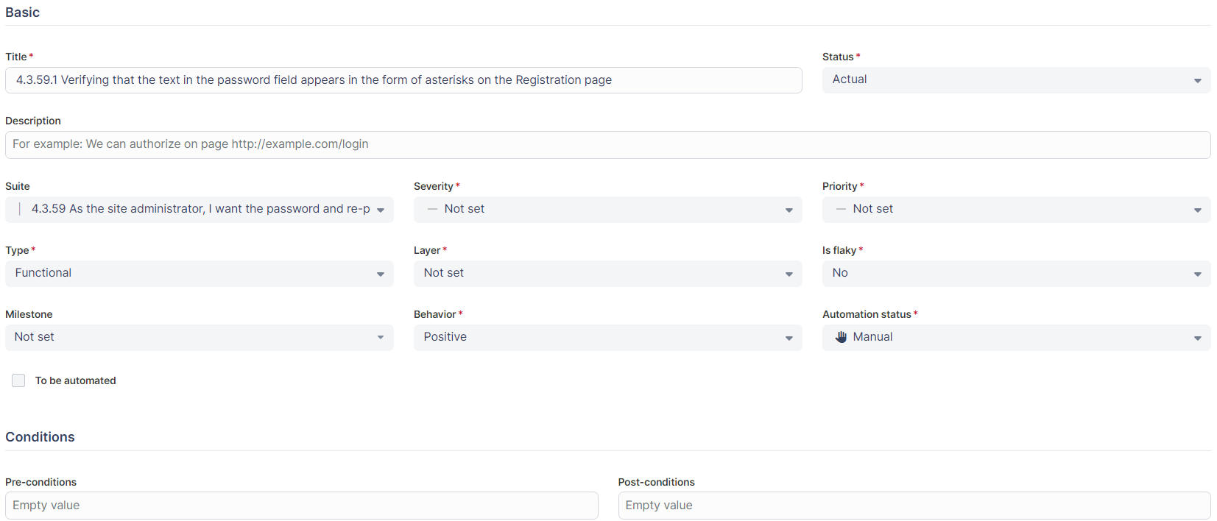
Test 4.3.59.1 Verifying that the text in the password field appears in the form of asterisks on the Registration page
Benny Feigin

Slide 29
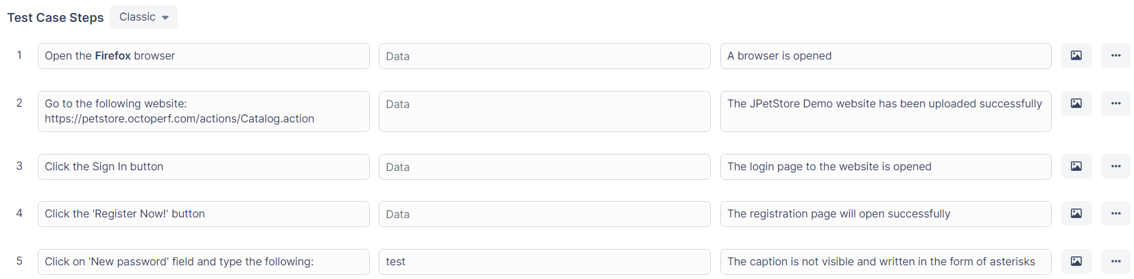
Benny Feigin
Test Case Steps

Slide 30
Benny Feigin
Requirement 4.3.45
I want the correct value of the fields: username, password, first name, password, address1,address2,city,country. will contain only the following characters: English uppercase and lowercase letters, spaces, hyphens, digits, underscores,slashes

Slide 31
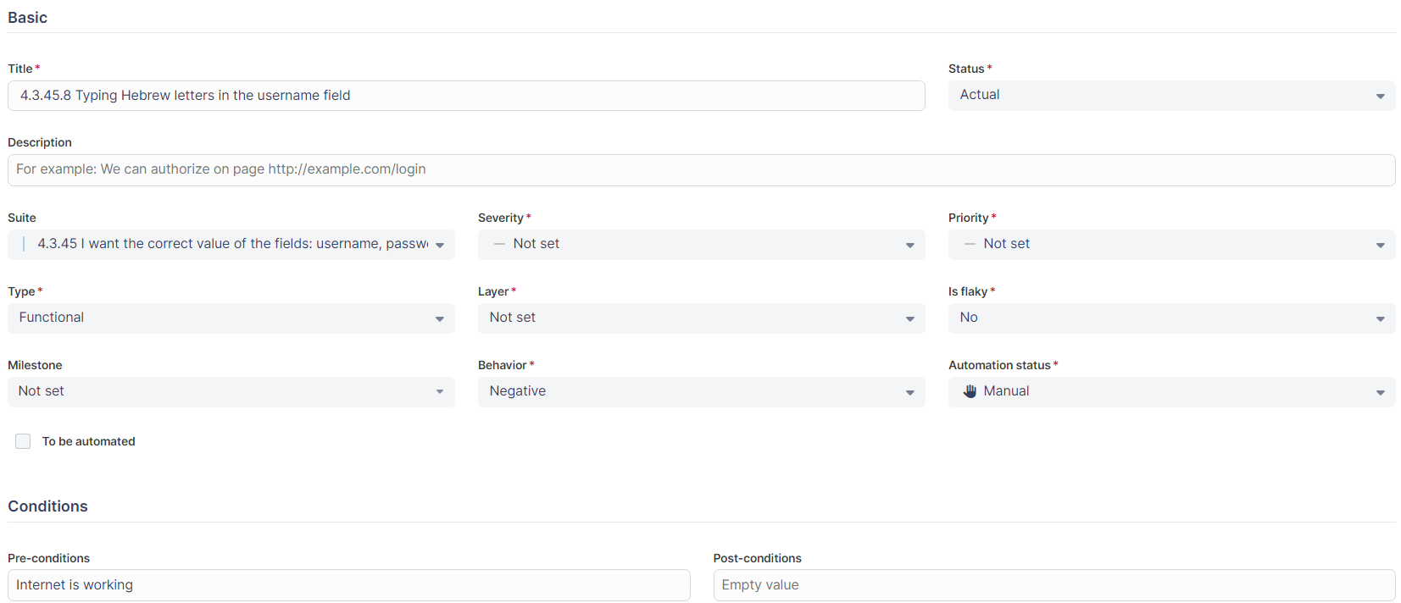
Benny Feigin
Test 4.3.45.8 Typing Hebrew letters in the username field

Slide 32
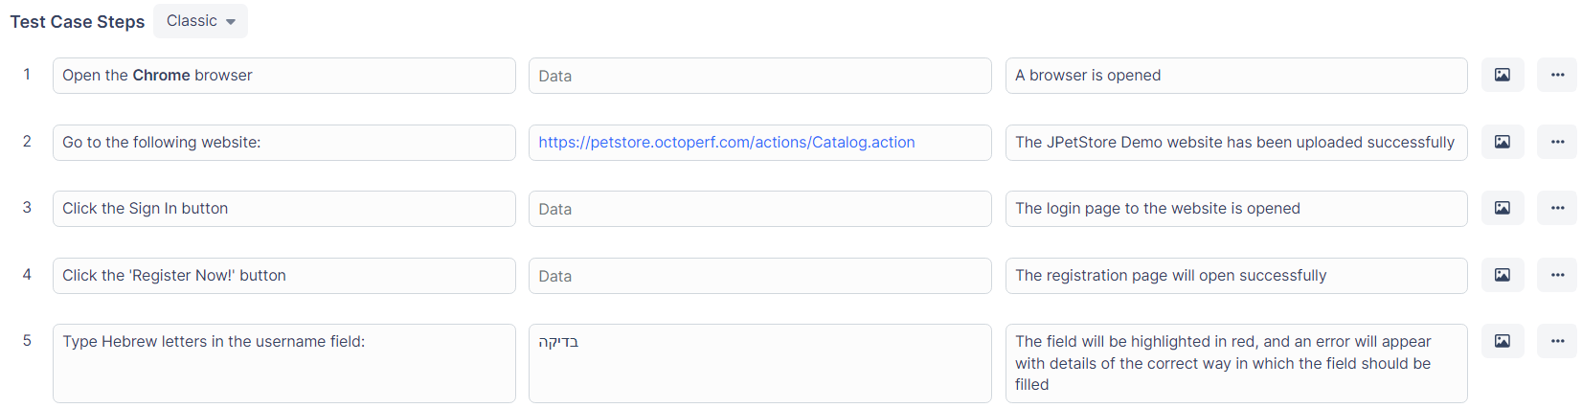
Benny Feigin
Test Case Steps

Slide 33
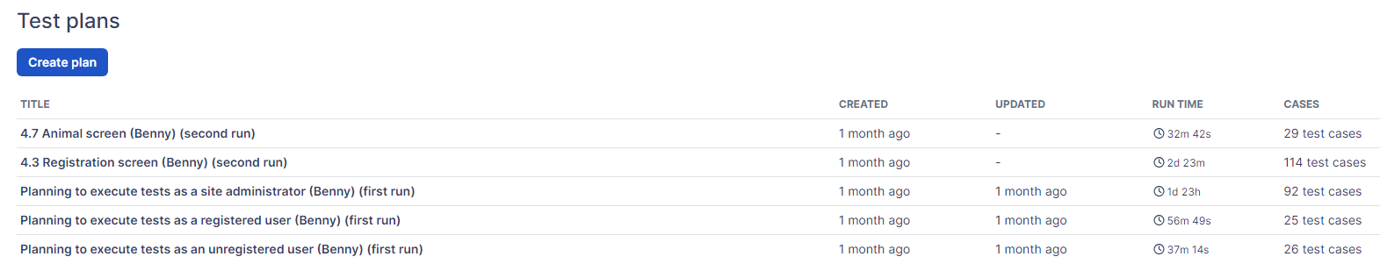
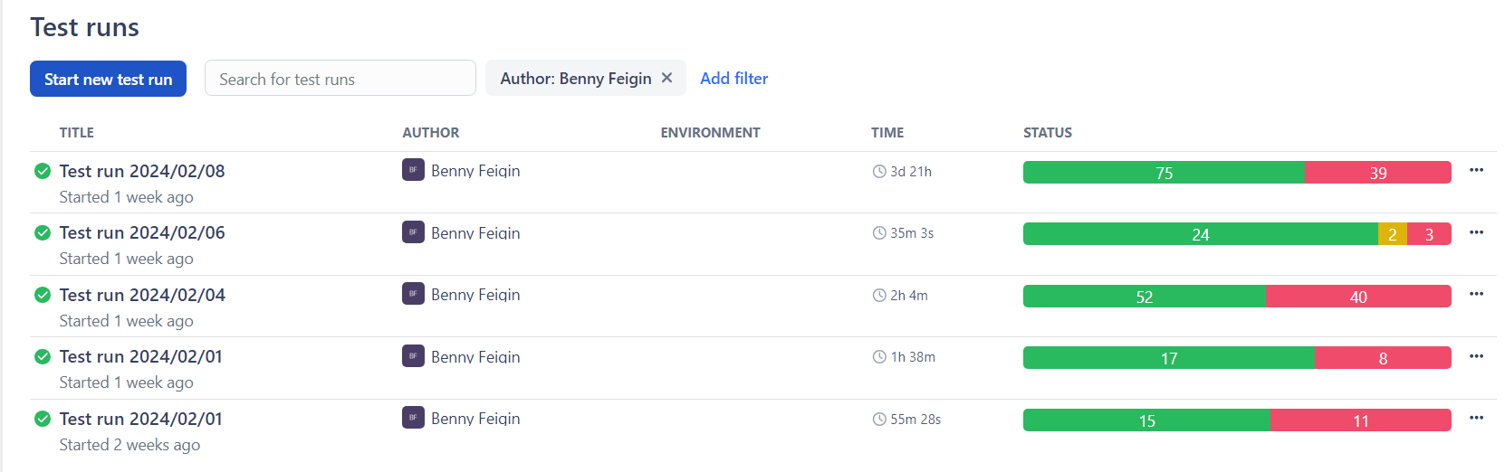
Test Plans & Test Runs
Benny Feigin

Slide 34
Benny Feigin
Issues
the following issues will be presented in the following slides:

Slide 35
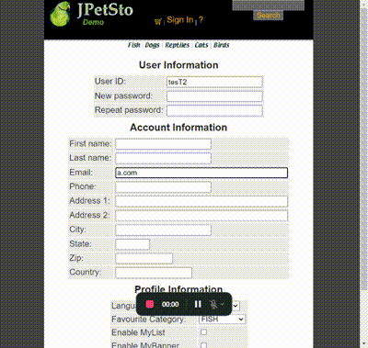
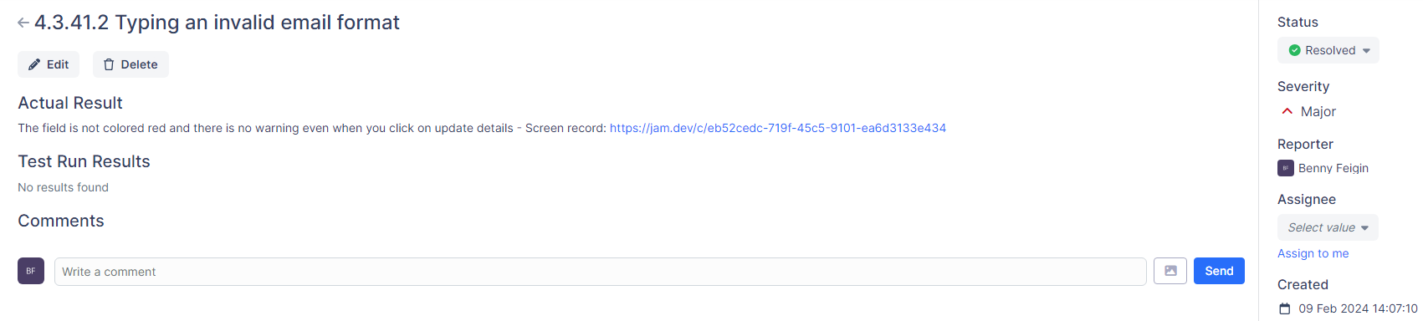
Benny Feigin
Test 4.3.41.2 - First Bug
Full video screen

Slide 36
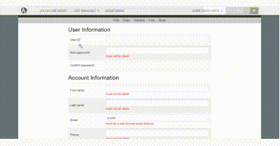

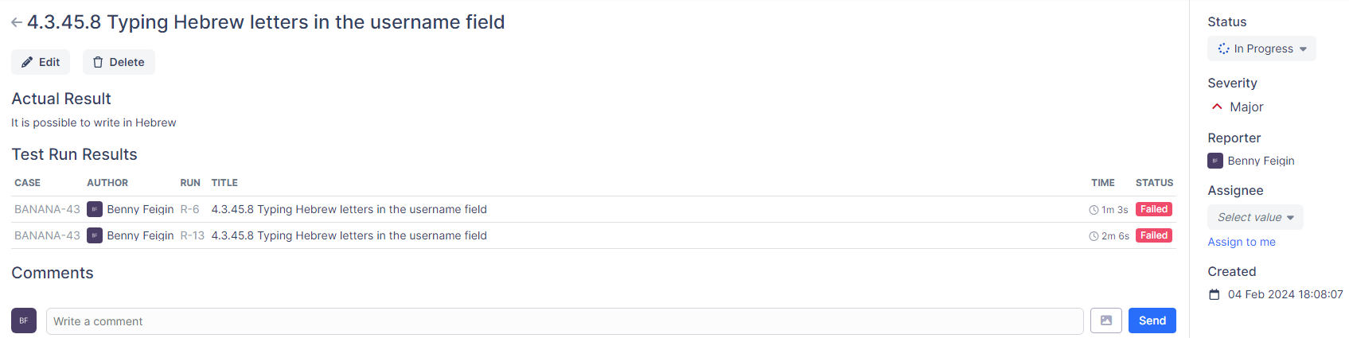
Benny Feigin
Test 4.3.45.8 - Second Bug
Full video screen
Full video screen

Slide 37
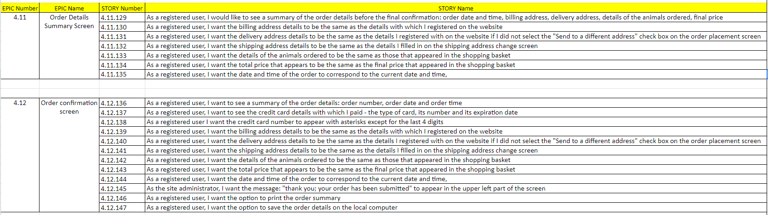
Natan Koren Requirement

Slide 38
Natan Koren test cases
The following test cases will be presented in the following slides:
Test 4.11.130.1 Comparing billing address details on the summary screen to details from Account information: First name field
Test 4.12.137.1 The type of card is displayed on the confirmation screen

Slide 39
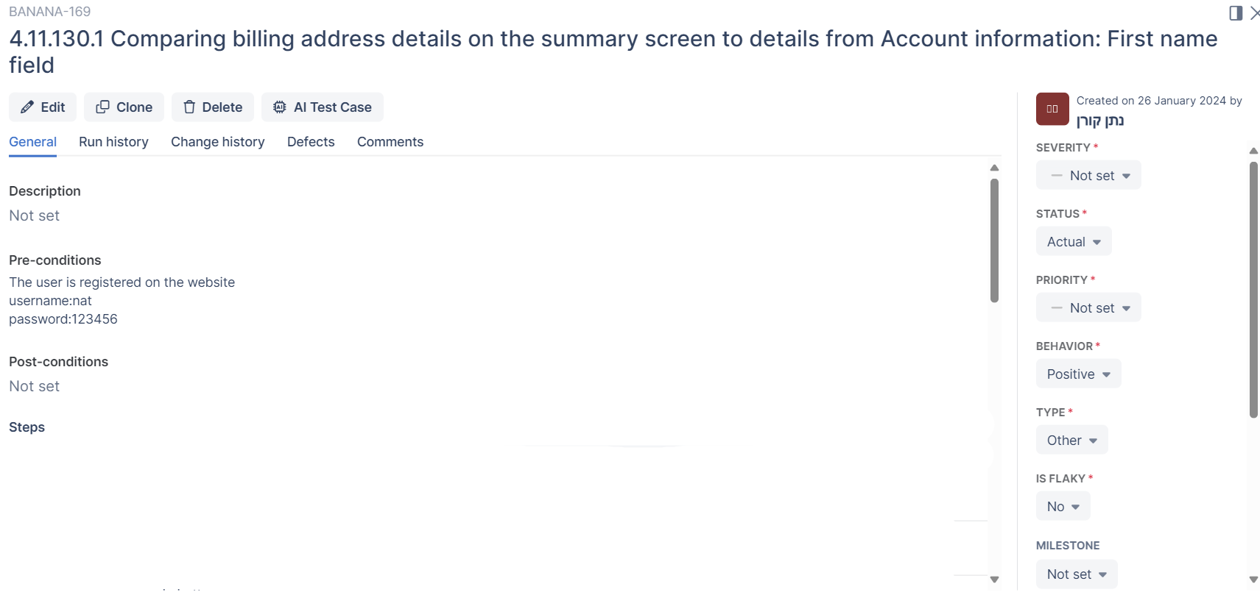
FIRST TEST CASE

Slide 40
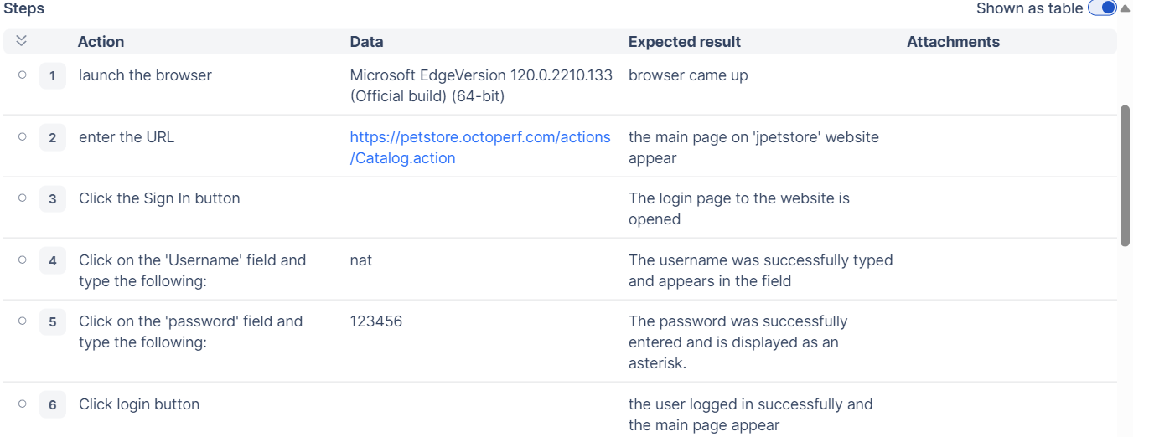
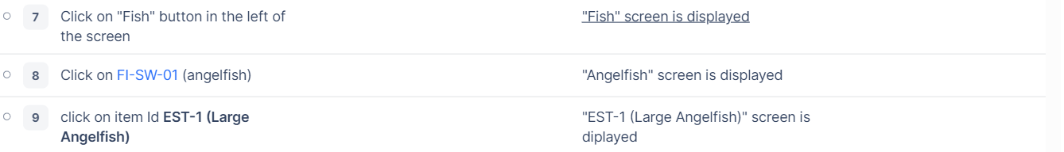

Slide 41
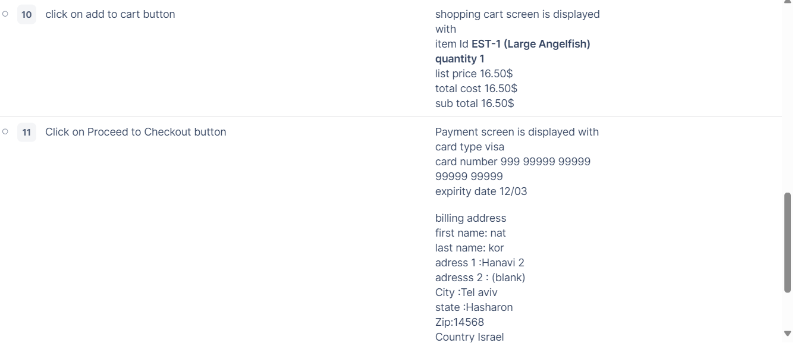
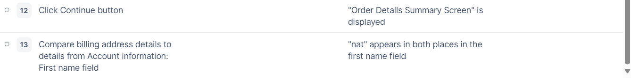

Slide 42
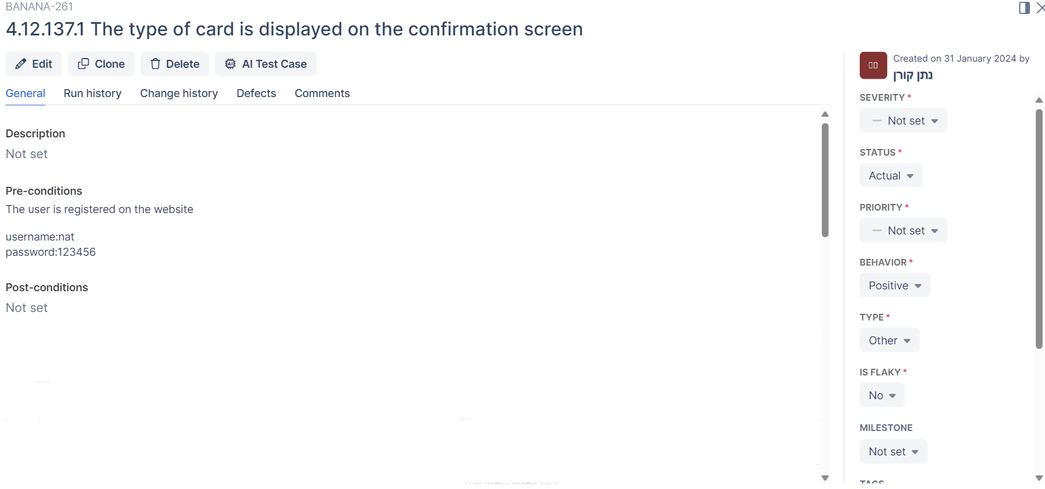
SECOND TEST CASE

Slide 43
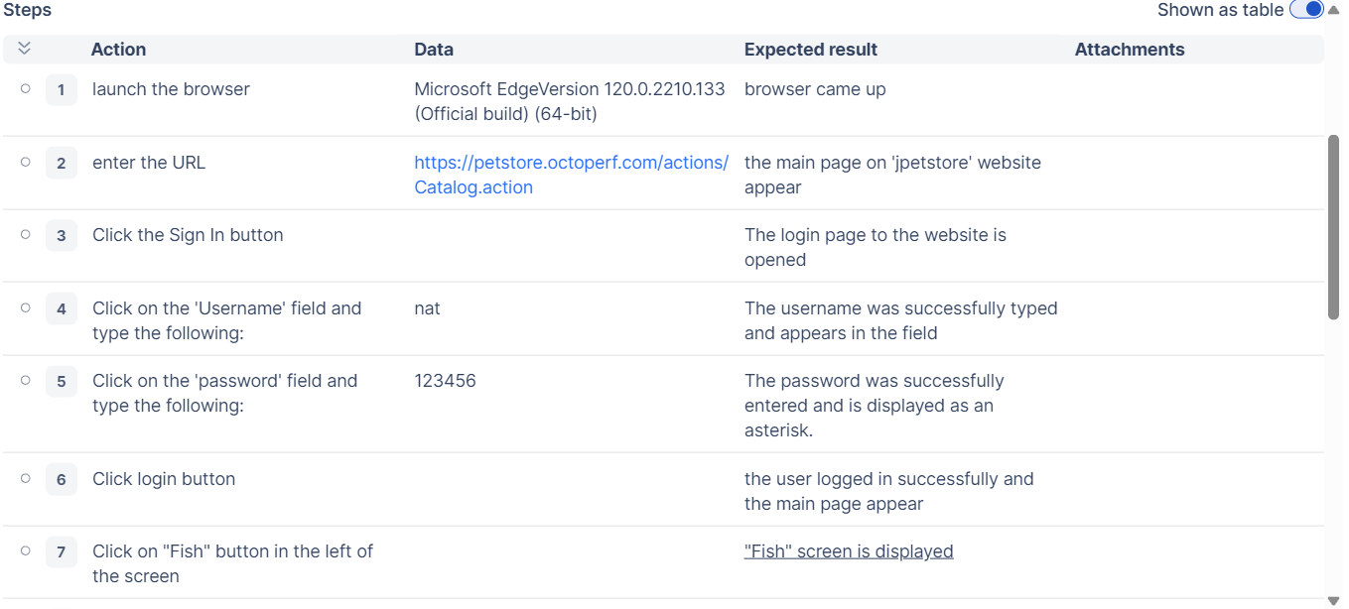

Slide 44
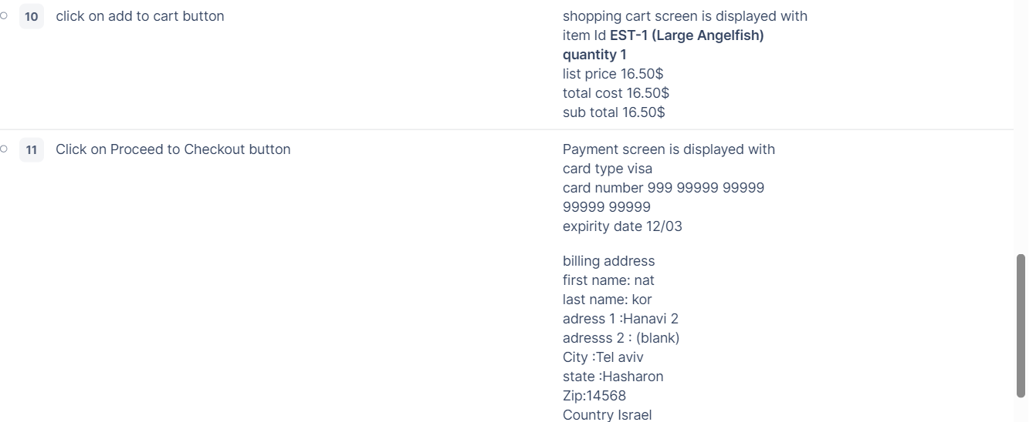
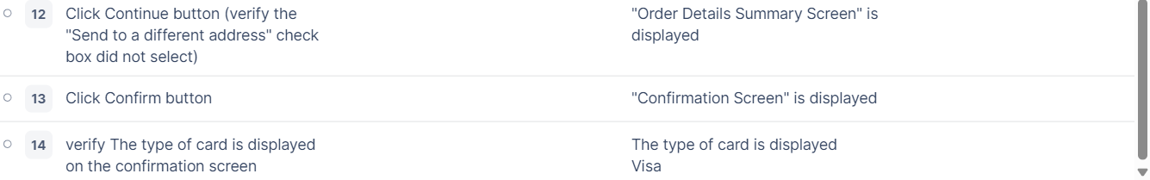

Slide 45
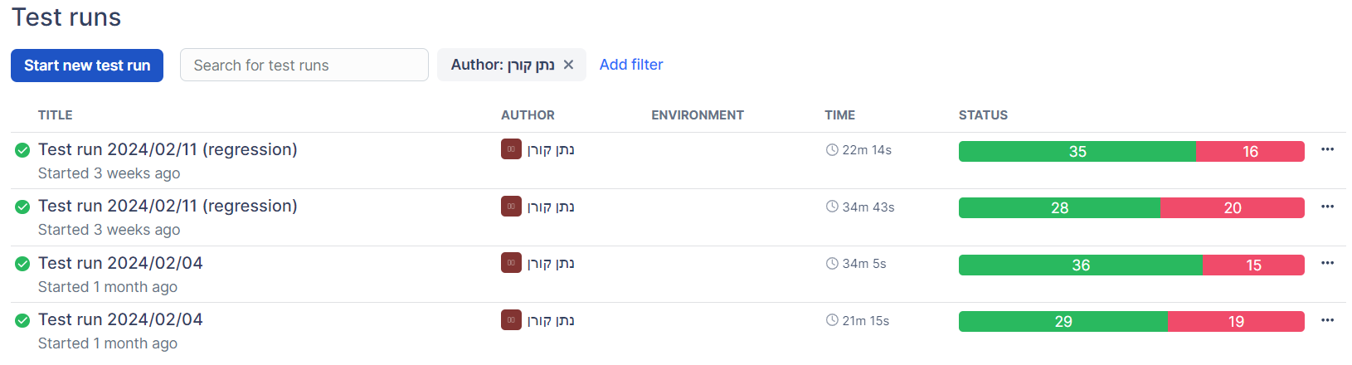
Status Test Runs

Slide 46
Natan Koren issues

Slide 47
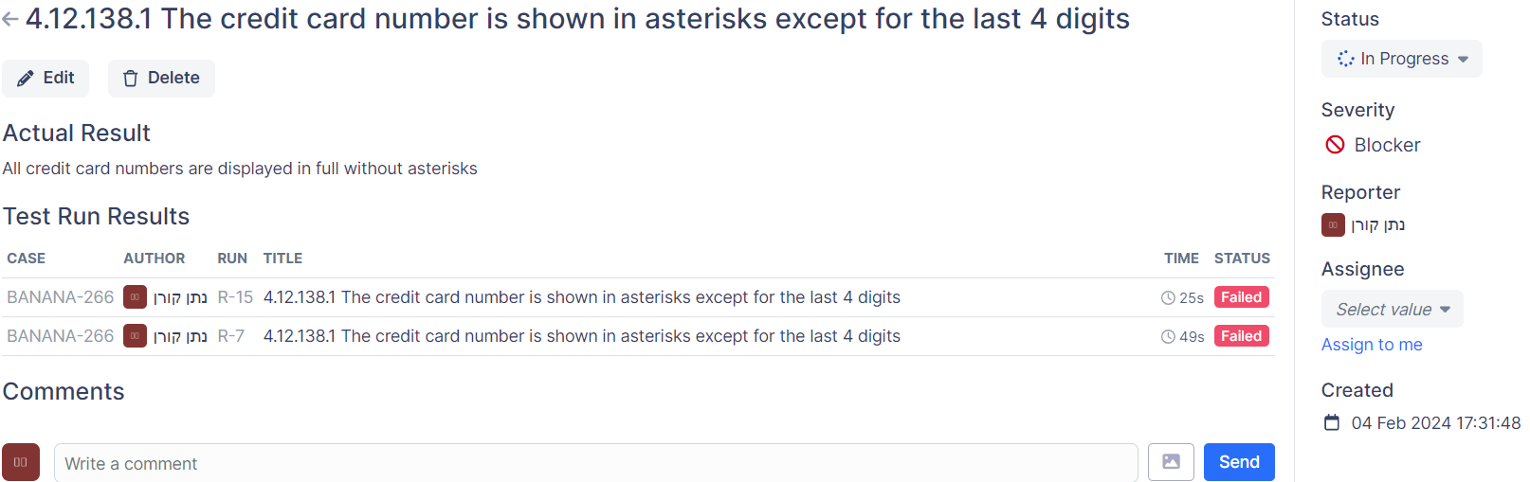
First Issue

Slide 48
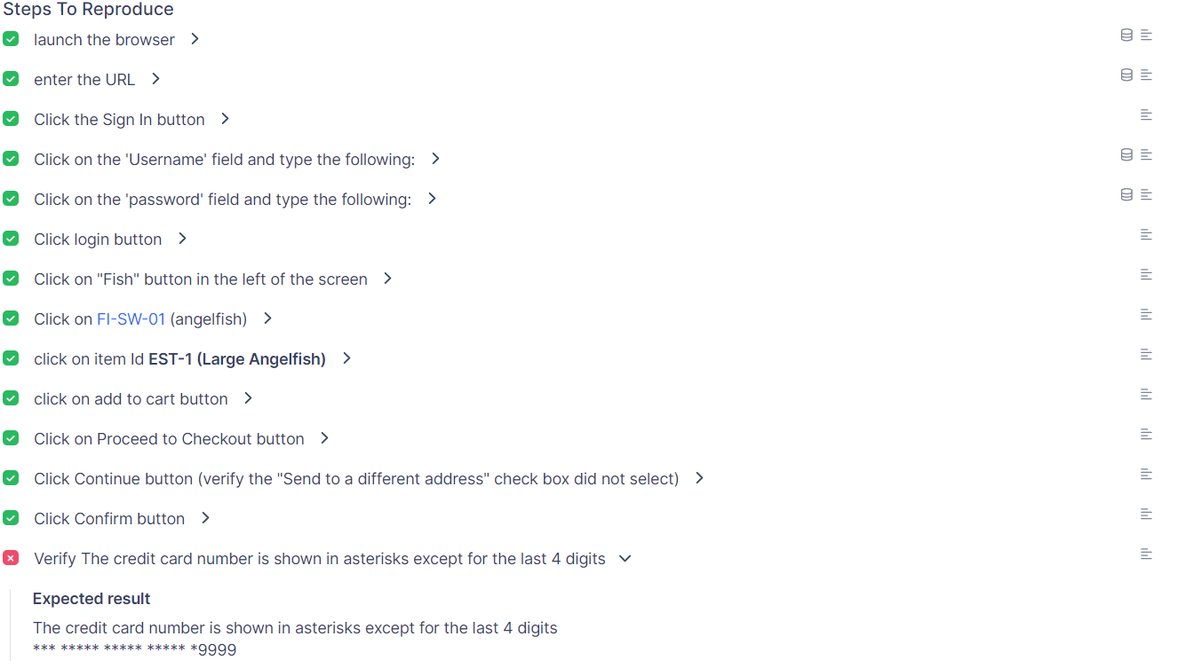
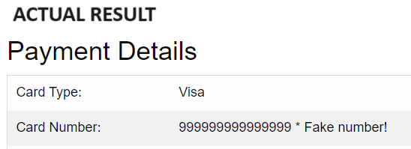

Slide 49
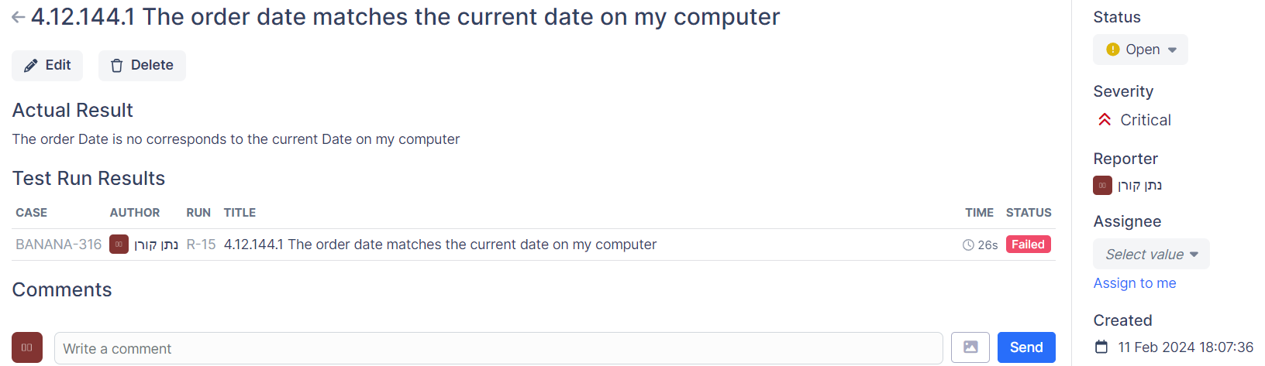
Second Issue

Slide 50
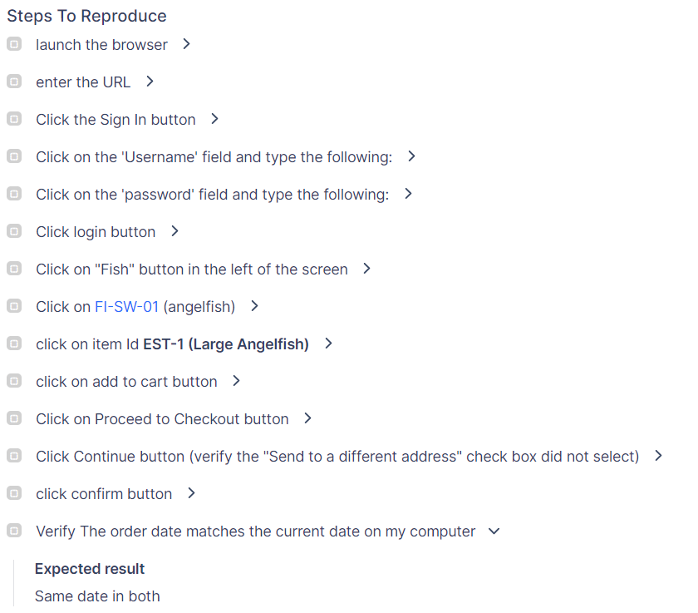
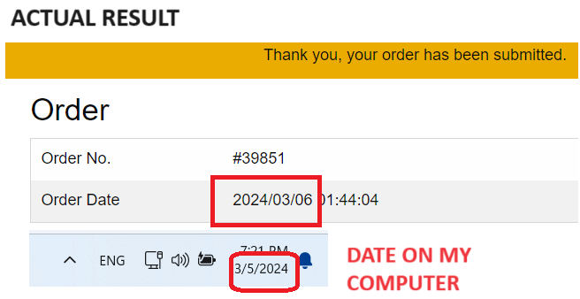

Slide 51

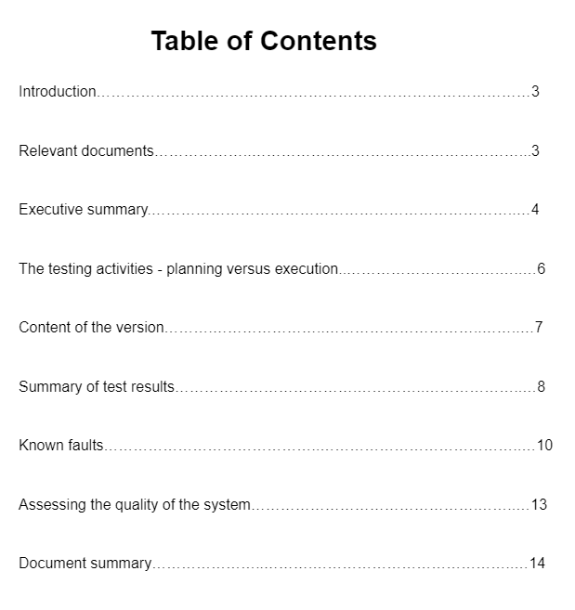

Link to STR Document

